Slide 1

Recruitment Management System
Group members with Student Id
SUSHANT MHATRE – 21104002
SHRUTI MANDAVKAR-21104038
SNEHA BHAVSAR-21104035
PRATIK INGALE-21104058
Project Guide Name - Prof. JAYSHREE JHA

Slide 2
Contents
Introduction
Objectives
Scope
Features / Functionality
Project Outcomes
Technology Stack
Block Diagram/ Flow

Slide 3
1. Introduction
Recruitment system includes the entire process of finding the prospective candidates, assessing, interviewing and hiring them, as per the job requirement.
The motivation behind recruitment is to make the procedures included more productive and powerful, and in addition more affordable.
Limitations:
1.An organization data base goes through many numbers of updates each day which is hard to maintain in registers.
2. Requires an active internet connection
Advantages:
1. Saves time
2. Easy to access the system anywhere and anytime

Slide 4
2. Objectives
To help applicants to find suitable job within the organization and apply for that job easily.
To help in managing and viewing details of interested applicants for the administrator.
To avoid the wastage of their time for finding right employee at right post.
To infuse freshers at all the levels of the organization.

Slide 5
3. Scope
  This multi platform solution brings in by default, the basic intelligence and immense possibilities for further intension of the application as required by the user.
  Our system makes its simpler to share and manage the recruitment system.
  Recruitment management systems have a range of components and functions. They include applicant tracking systems for managing job postings and applications, and customer relationship management-type functions to keep applicants connected and engaged. Many of these tasks are automated.

Slide 6
4. Feature /Functionality
1. RECORD:
Our recruitment system record all the details of the applicant.
2. Administrative facility:
Our system should have the facility of administrative help for user to solve his important problems , Allow admin to filter or sort according to given filter.
3. Vacancy:
It should allow admin to display vacancy within the organization.

Slide 7
5. Outcome of Project
Improved efficiency in the recruitment process: which can significantly reduce the time and effort required to manage the recruitment process.
Better candidate experience: A well-designed recruitment management system can provide.
A positive experience for candidates by keeping them informed about the recruitment.
Increased transparency and accountability.
It has enhanced data management.

Slide 8



6. Technology Stack
Write what you have planned to develop front end ( GUI ) & Backend (Database if applicable)
PYTHON
MYSQL
XAMPP

Slide 9
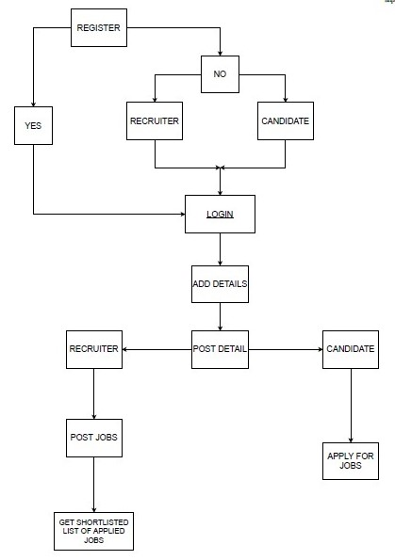
7. Block Diagram/ Flow Chart

Slide 10
Thank You...!!

